Slide 1
UNIT II – CHapter 1 Windows Forms

Slide 2
Windows Forms
Forms represent windows that will appear in user’s application. Forms allow the designers to add controls and other items from the toolbox. The support for Windows form is in the System.Windows.Forms namespace and the form class is System.Windows.Forms.Form.

Slide 3
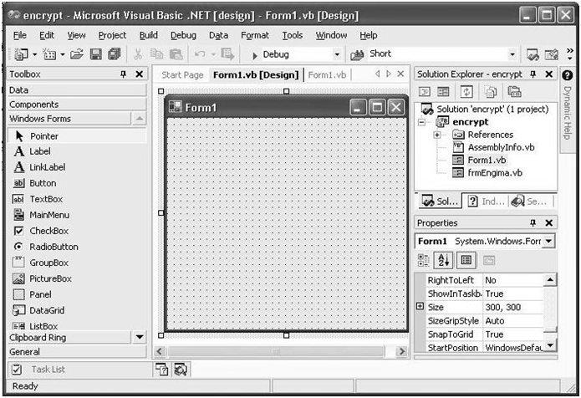

Slide 4
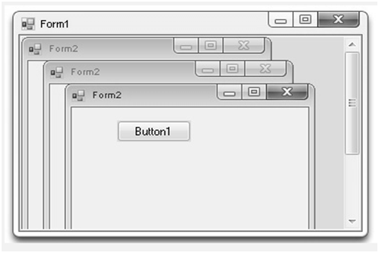
MDI Forms
Multiple Document Interface (MDI) form closely resembles a standard form with one major difference—the client area of MDI form encloses other forms. MDI form is also called as MDI parent, can display MDI children in it. MDI child forms appear in MDI child window, otherwise are similar to standard forms.

Slide 5
Adding Controls to Forms
Users interact using different controls such as buttons, text boxes menus and so on. All these are called as controls.
Controls can be added to a form by drag-and-drop operation which involves selection of control from the toolbox and placing it on the form.
The properties of different controls can be changed by selecting the control and changing the specific property in the properties window.

Slide 6
Setting Borders to a Form
FormBorderStyle property is used to set borders to a form. the possible values for this property are:
Fixed3D—A fixed three-dimensional border.
DixedDialog—A thick,fixed dialog style border.
FixedSingle—A fixed single line border.
FixedToolWindow—A tool window border that is not resizable.
None—No border.
Sizable—A resizable border.
SizableToolWindow—A resizable tool window border.

Slide 7
Setting Tab Order for Controls:
To set Tab order to controls, following steps are to be followed:
The control whose tab order needs to be set must be selected.
The TabStop property of the selected control must be set to True. If this property is False, user cannot reach the control using Tab key.
The TabIndex property value of the control must be changed. The first control should have TabIndex 0, the next a TabIndex of 1 and so on.
When the program is executed, the first control is highlighted. When the user presses the Tab key, the focus is moved to the second control (with TabIndex 1) and so on.

Slide 8
Setting Initial Position for the Form:
The FormStartupPosition property is used to specify the initial position for the form. Possible values are:
CenterParent—The form is centered within the bounds of its parent form.
CenterScreen—The form is centered on the current display and has dimensions specified in the size of the form.
Manual—The Location and Size properties of the form will determine its starting position.
WindowsDefaultBounds—The form is positioned at the Windows default location and has the bounds determined by Windows default.
WindowsDefaultLocation—The form is positioned at the Windows default location and has the dimensions specified in the size of the form.

Slide 9
Moving and sizing Forms and Controls in Code:
Move method is used to move forms and controls
It can also achieved using control’s Location property and Point method.
Height and Width methods to set the dimensions of the controls
it can also achieved using control’s Size property and Size method.
Example:

Slide 10
The SetBounds method can also be used to resize the controls.
Syntax:
Overloads Public Sub SetBounds(ByVal x As Integer, ByVal y As Integer, ByVal width As Integer, ByVal height As Integer)
x – the new Left Property value of the control
y – the new Right Property value of the control
width – the new Width Property value of the control
height – the new Height Property value of the control

Slide 11
Message Box
Public Function MsgBox(Prompt As Object [, Buttons As MsgBoxStyle = MsgBoxStyle.OKOnly [, Title As Object = Nothing]]) As MsgBoxResultArguments

Slide 12
Constant | Value | Description
OKOnly | 0 | Shows OK button only.
OKCancel | 1 | Shows OK and Cancel buttons.
AbortRetryIgnore | 2 | Shows Abort, Retry, and Ignore buttons.
YesNoCancel | 3 | Shows Yes, No, and Cancel buttons.
YesNo | 4 | Shows Yes and No buttons.
RetryCancel | 5 | Shows Retry and Cancel buttons.
Critical | 16 | Shows Critical Message icon.
Question | 32 | Shows Warning Query icon.

Slide 13
Exclamation | 48 | Shows Warning Message icon.
Information | 64 | Shows Information Message icon.
DefaultButton1 | 0 | First button is default.
DefaultButton2 | 256 | Second button is default.
DefaultButton3 | 512 | Third button is default.
ApplicationModal | 0 | Application modal, which means the user must respond to the message box before continuing work in the current application.
SystemModal | 4096 | System modal, which means all applications are unavailable until the user dismisses the message box.
MsgBoxSetForeground | 65536 | Specifies the message box window as the foreground window.
MsgBoxRight | 524288 | Text will be right-aligned.
MsgBoxRtlReading | 1048576 | Specifies text should appear as right-to-left on RTL systems such as Hebrew and Arabic.

Slide 14
Message.Show Method
Overloads Public Shared Function Show(ByVal text As String, ByVal caption As String, ByVal buttons As MessageBoxButtons, ByVal icon As MessageBoxIcon, ByVal defaultButton As MessageBoxDefaultButton, ByVal options As MessageBoxOptions ) As DialogResult

Slide 15
MessageBoxButtons
AbortRetryIgnore— The message box will show Abort, Retry, and Ignore buttons.
OK— The message box will show an OK button.
OKCancel— The message box will show OK and Cancel buttons.
RetryCancel— The message box will show Retry and Cancel buttons.
YesNo— The message box will show Yes and No buttons.
YesNoCancel— The message box will show Yes, No, and Cancel buttons.

Slide 16
MessageBoxIcon
Asterisk— Shows an icon displaying a lowercase letter i in a circle.
Error— Shows an icon displaying a white X in a circle with a red background.
Exclamation— Shows an icon displaying an exclamation point in a triangle with a yellow background.
Hand— Shows an icon displaying a white X in a circle with a red background.
Information— Shows an icon displaying a lowercase letter i in a circle.
None— Shows no icons.
Question— Shows an icon displaying a question mark in a circle.
Stop— Shows an icon displaying white X in a circle with a red background.
Warning— Shows an icon displaying an exclamation point in a triangle with a yellow background.

Slide 17
MessageBoxOptions
DefaultDesktopOnly— Displays the message box on the active desktop.
RightAlign— The message box text is right-aligned.
RtlReading— Specifies that the message box text is displayed with right to left reading order.

Slide 18
Input Box
Public Function InputBox(Prompt As String [, Title As String = "" [, DefaultResponse As String = "" [, XPos As Integer = -1 [, YPos As Integer = -1]]]]) As String

Slide 19
Prompt— A string expression displayed as the message in the dialog box. The maximum length is about 1,024 characters (depending on the width of the characters used).
Title— String expression displayed in the title bar of the dialog box. Note that if you omit Title, the application name is placed in the title bar.
DefaultResponse— A string expression displayed in the text box as the default response if no other input is provided. Note that if you omit DefaultResponse, the displayed text box is empty.
XPos— The distance in pixels of the left edge of the dialog box from the left edge of the screen. Note that if you omit XPos, the dialog box is centered horizontally.
YPos— The distance in pixels of the upper edge of the dialog box from the top of the screen. Note that if you omit YPos, the dialog box is positioned vertically about one-third of the way down the screen.

